Slide 1
ChatApp
Mridula Natrajan
Hari Shreenivash Madras Vanamamalai
Rajarshi Basak

Slide 2
Why ChatApp
Instant messaging system
Chat with friends
Manage user profiles
Group Messaging

Slide 3
Model - View - Controller
One central Model class which talks to the database
A total of 3 controllers in our project for the three main modules
Profile Management
Contact Management
Group Management
The chatDB consists of 5 tables:
Groupinfo
Group
Users
Contacts
profileinfo

Slide 4
Technologies
MySQL Database
Java Swing GUI
Eclipse (Java IDE)
Eclipse Window Builder
JDBC (IDE to Database connector)

Slide 5
Design Pattern - Observer
Useful when one is interested in the state of an object and wishes to get notified whenever there is a change
Group Chat
Subject - Group Message
Observer - Group Member

Slide 6
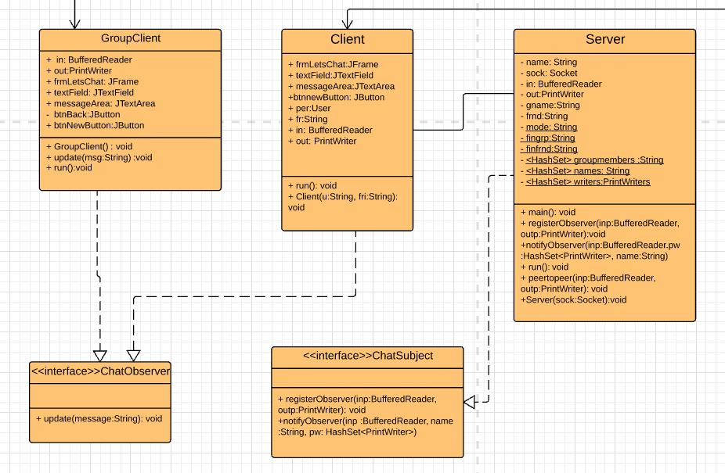
Design Pattern - Observer

Slide 7
Improvements
Memento - saving chat history
Other use-cases
Improving the UI

Slide 8
Thank you!

